Slide 1
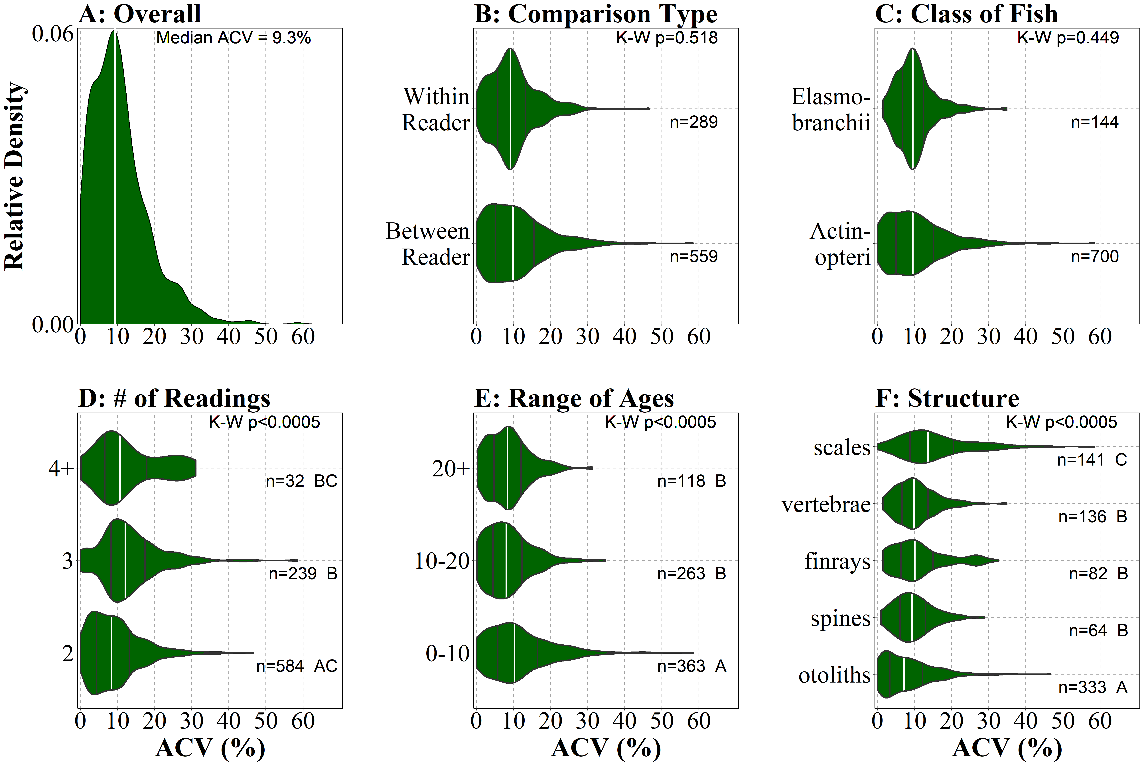
Precision Metrics Summarized from 20+ years of Fish Age Estimation Studies
Joshua F. Lyons and Derek H. Ogle • Northland College
Background
Results
Age estimation of fish is crucial for the assessment of fish population dynamics and stock structure.
Precision is the repeatability of age estimates among multiple readings of calcified structures.
Common measures of precision are percent agreement, average percent error (APE), and average coefficient of variation (ACV).
Campana (2001) reviewed the use of precision measures in the fisheries literature.
suggested using ACV in most cases.
reported a modal observed ACV of 5%.
Two-thirds of reviewed papers published after 2001 used an ACV to measure precision.
USE OF ACV DIFFERED???? AMONG ???
The distribution of ACV was strongly right-skewed with a median of 9.3% and a mode of 9-10% (Fig. A)
Median ACV did not differ between between- and within-reader comparisons (Fig. B) or between Actinopterii and Elasmobranchii classes (Fig C).
Median ACV for 2 repeated readings was significantly lower that median ACV for 3 repeated readings, but statistically the same for more than 4 repeated readings (Fig. D).
Median ACV for results with 0-10 observed ages was significantly higher than the median ACV for results with 10-20 and more than 20 observed ages (Fig. E.).
Median ACV for results using otoliths was significantly lower than the median ACV spines, finrays, and vertebrae, which all had a median ACV lower that the median ACV for scales (Fig. F).
Objectives
Determine if papers since Campana (2001) primarily used the ACV.
Assess if the modal observed ACV value reported by Campana (2001) has changed.
Determine how ACV is affected by the type of comparison, class of fish, number of readings, range of observed ages, and type of calcified structure.
Methods
Obtained 313 papers published since 1983 that reported precision metrics of ageing fish.
Reviewed the papers and assessed method and results for use of precision metrics.
Used Chi-Square Test to examine differences in percentage of papers that used ACV by various characteristics of the study.
Used Kruskal-Wallis Test (and Dunn’s post hoc test) examine differences in median ACV by various characteristics of the study.
Figure. Density of observed ACV values over all studies (A) and by comparison type (B), class of fish (C), number of repeated readings (D), range of observed ages (E), and type of calcified structure (F). Vertical white lines are the median, black lines are Q1 and Q3.
Conclusions &
Management Implications
Overall ACV seems to be higher than that reported in Campana (2001).
Variability in ACV is explained by aspects of the analysis; e.g., number of repeated readings, range of ages, structure type.
Our results will allow for more specific and nuanced comparisons for future studies.

